Slide 1


Virtual Stock
Market
Trade freely . No money involved. Learn with paper currency

Slide 2
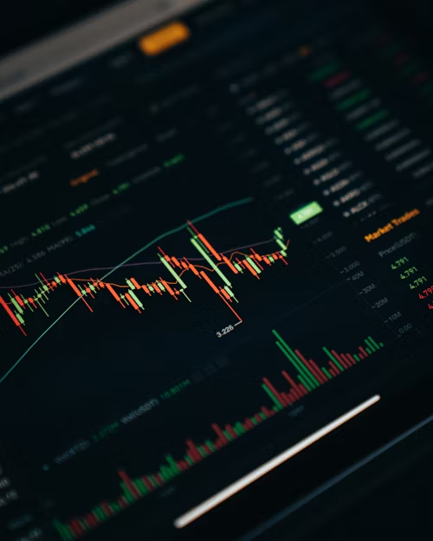
ABOUT THE PLATFORM
Makes Trading Simple
Facilitates risk-free trading with virtual currency
Ensuring a safe environment for beginners
Featuring an intuitive interface
An initial allocation of $10,000 for practice.

Slide 3
SIGN UP PAGE
Simple sign-up process
Required fields: username, email, password
Verification process

Slide 4
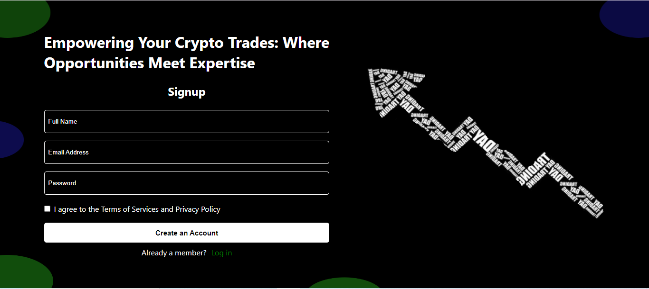
SIGN UP PAGE

Slide 5
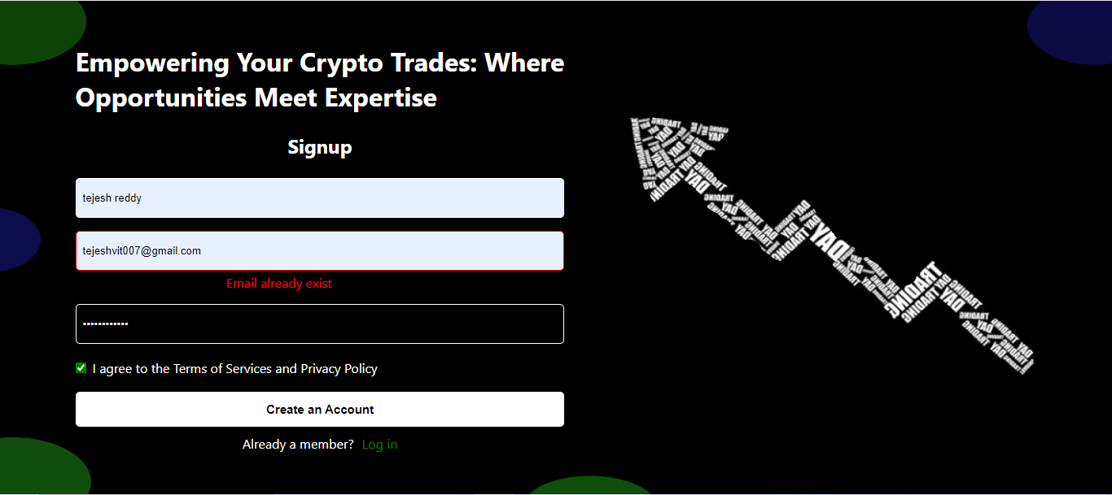
SIGN UP PAGE

Slide 6
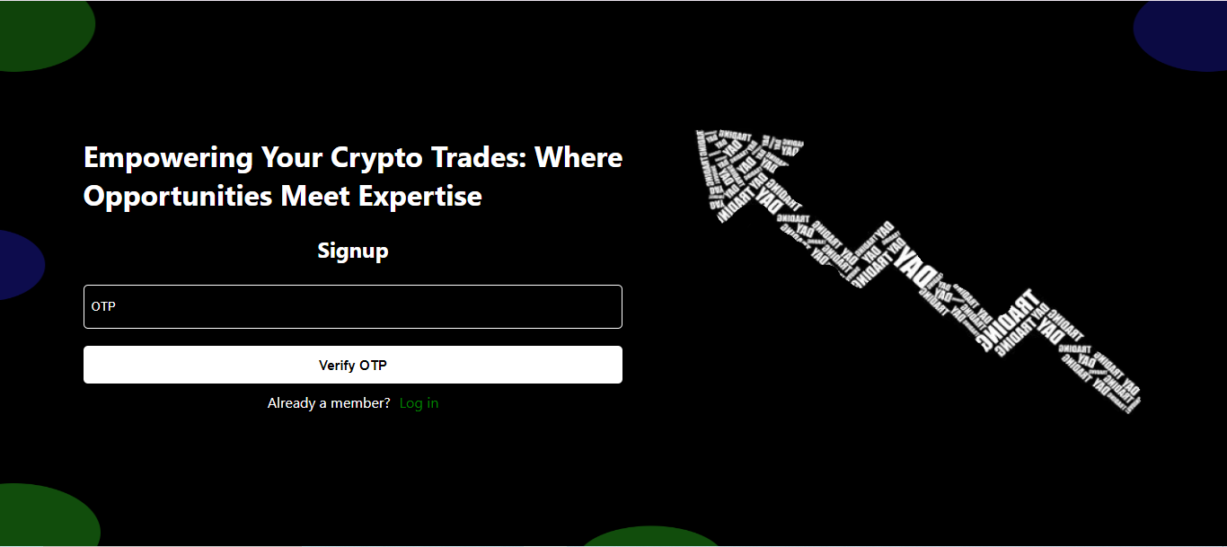
SIGN UP PAGE

Slide 7
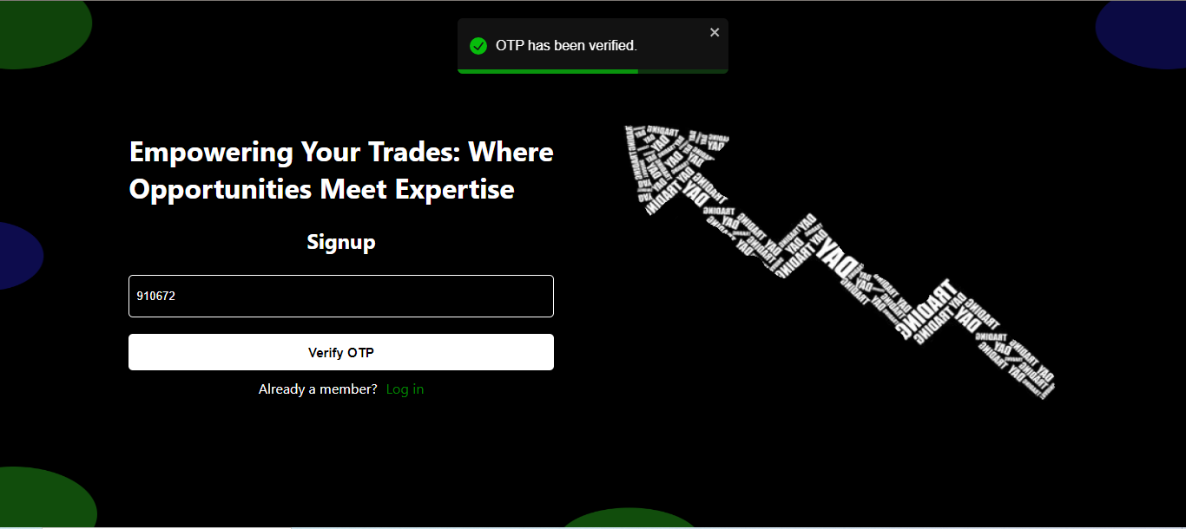
SIGN UP PAGE

Slide 8
LOGIN PAGE
Email entry
Password field
Remember me option
Login button

Slide 9
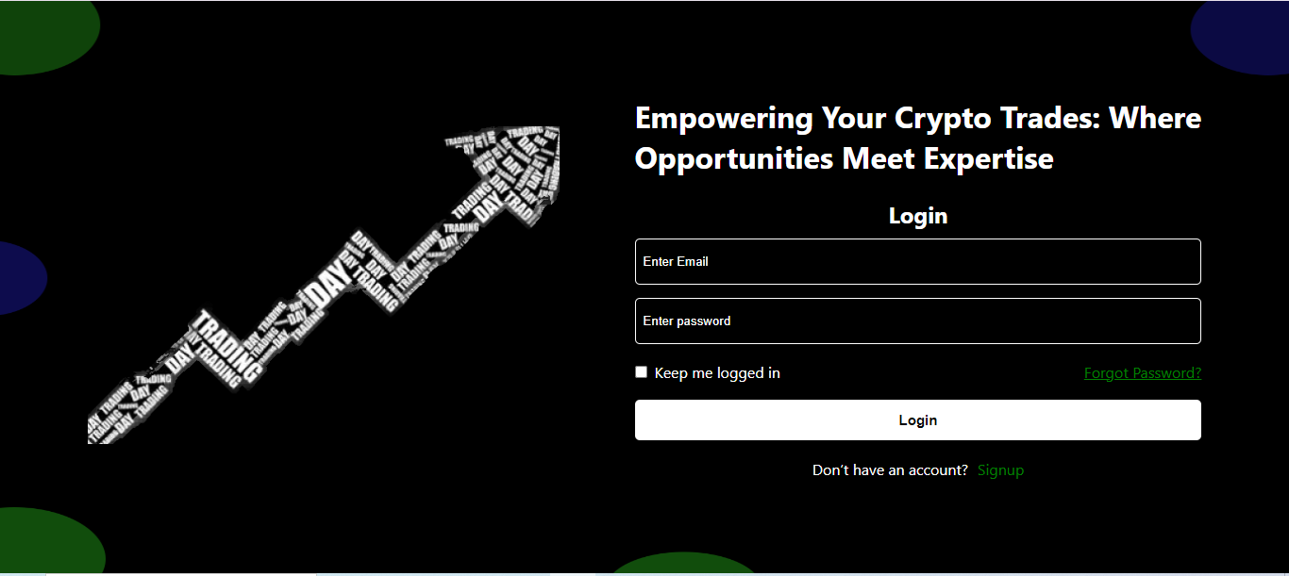
LOGIN PAGE

Slide 10
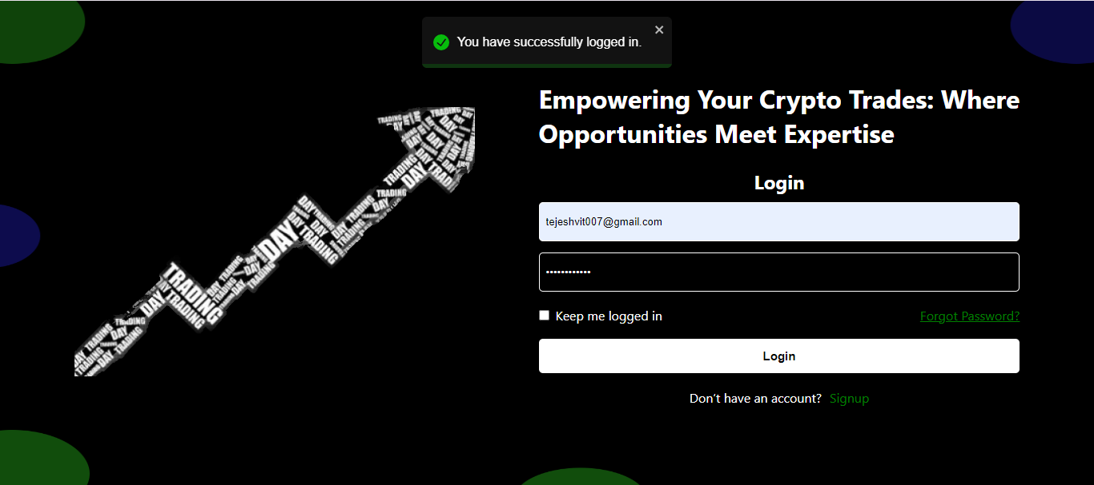
LOGIN PAGE

Slide 11
FORGOT PASSWORD
Enter registered email
Request OTP to reset the Password
Verify the OTP

Slide 12
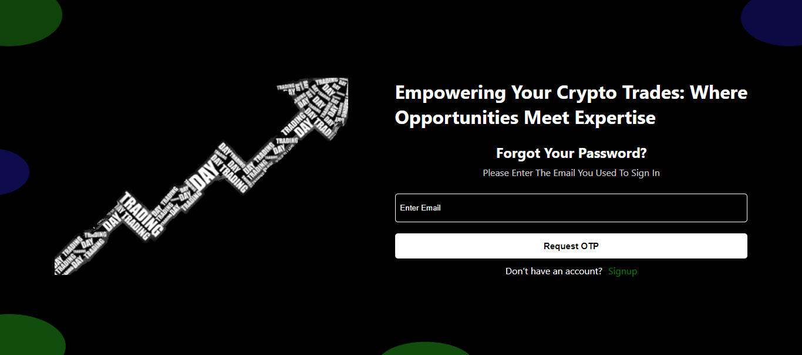
GET OTP

Slide 13
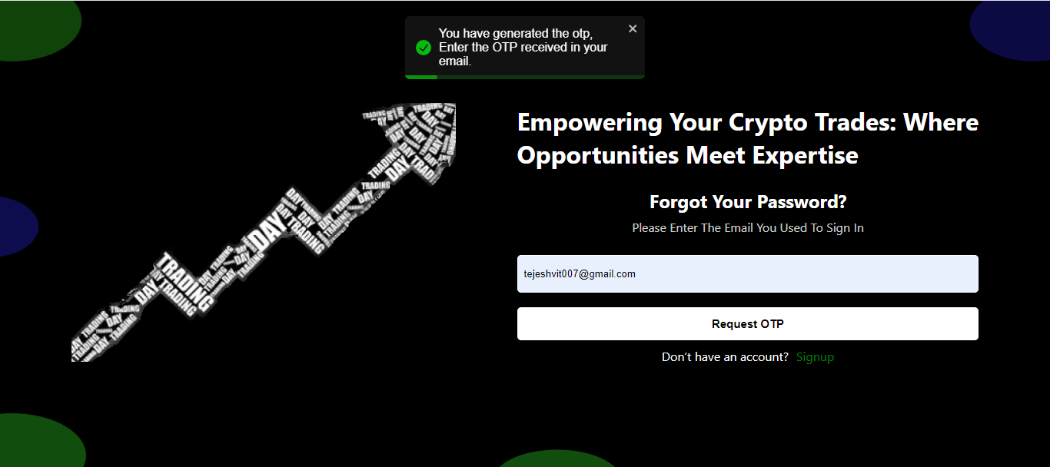
GET OTP

Slide 14

VERIFY OTP

Slide 15
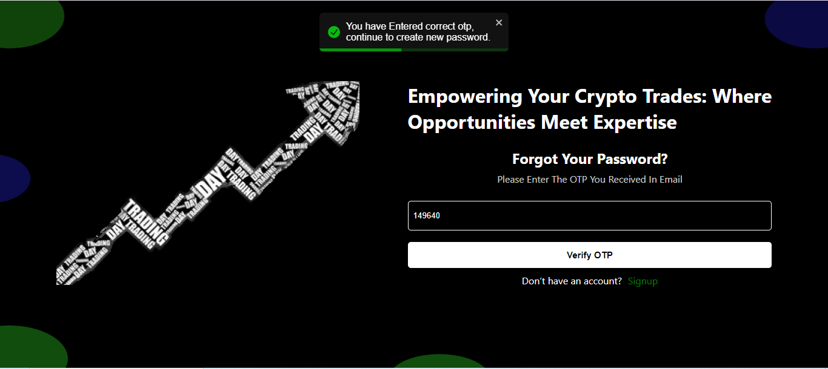
VERIFY OTP

Slide 16
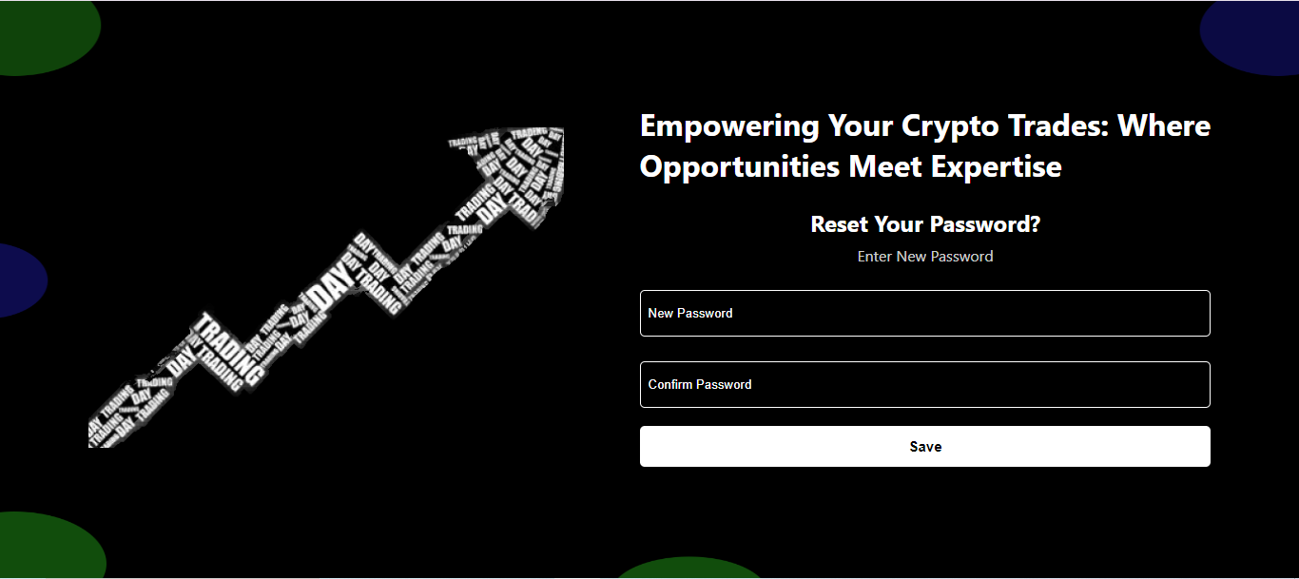
NEW PASSWORD

Slide 17
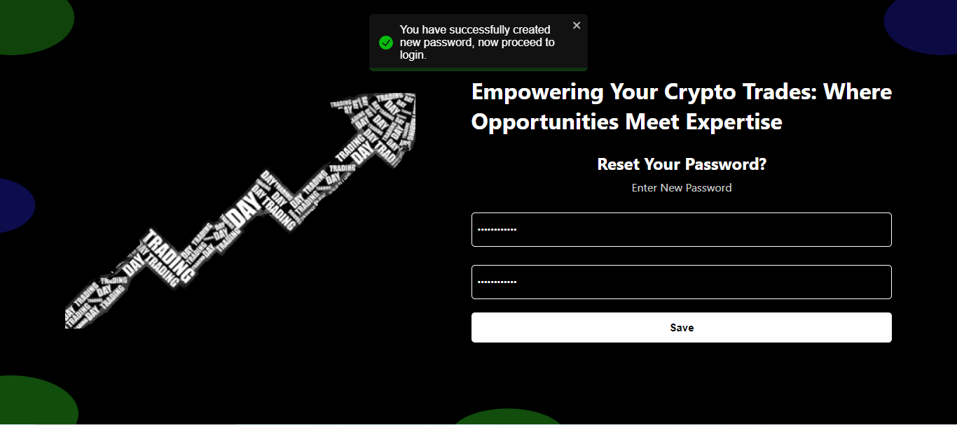
NEW PASSWORD

Slide 18
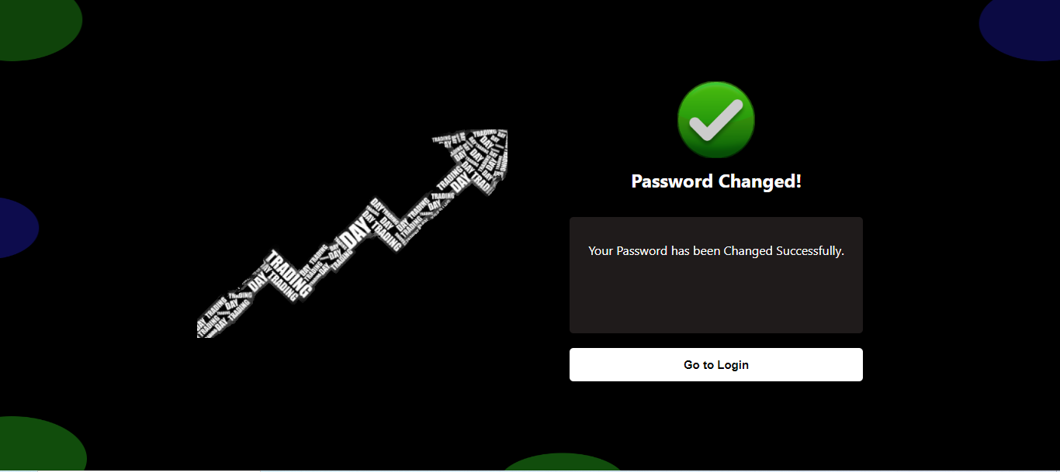
SUCCESS

Slide 19
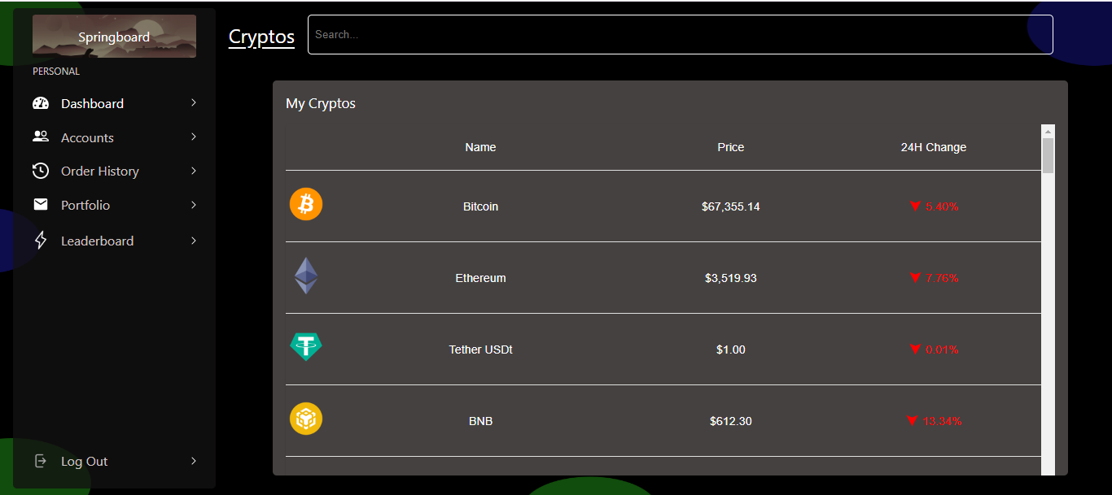
DASHBOARD

Slide 20
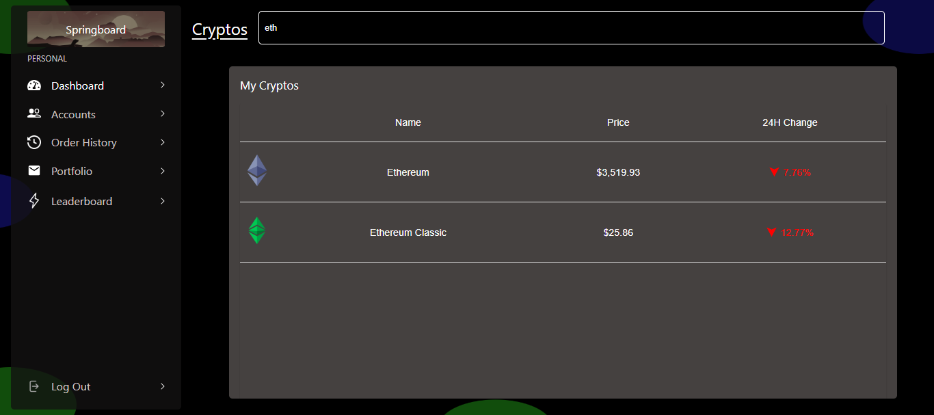
DASHBOARD

Slide 21
CRYPTO PURCHASE
Select Crypto to Buy
See Crypto Details
Check Balance
Select quantity
Confirm purchase

Slide 22
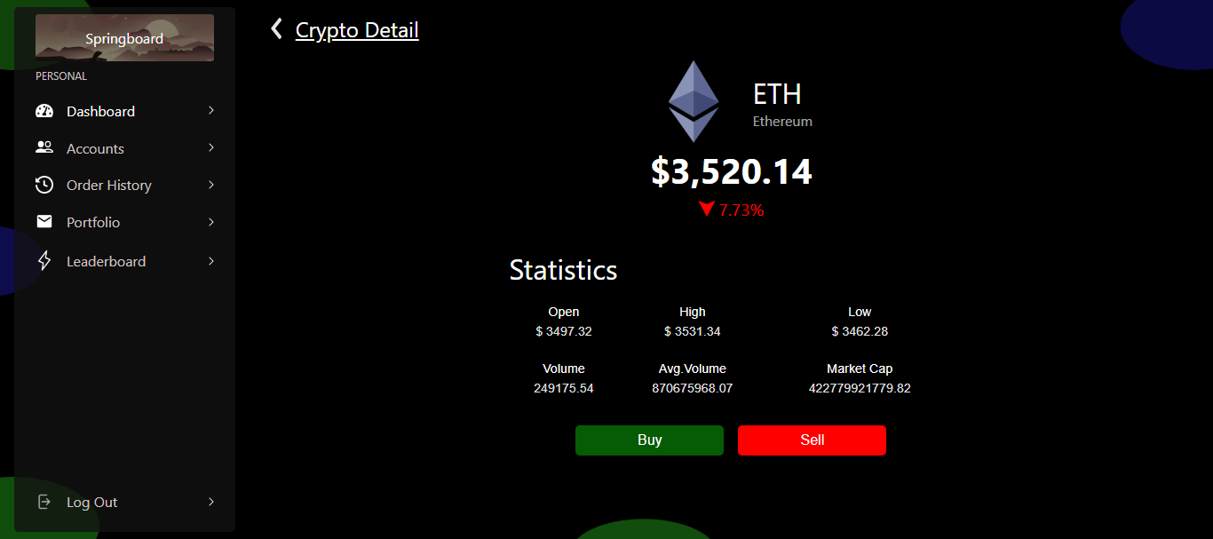
CRYPTO DETAIL

Slide 23
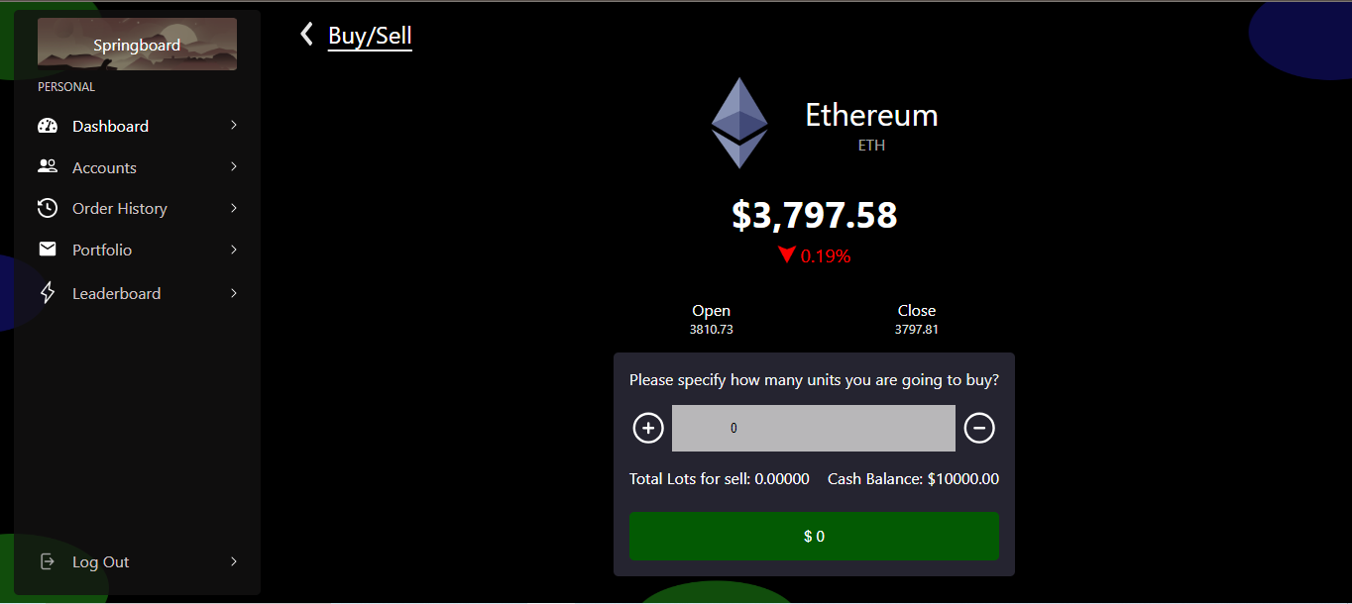
BUY

Slide 24
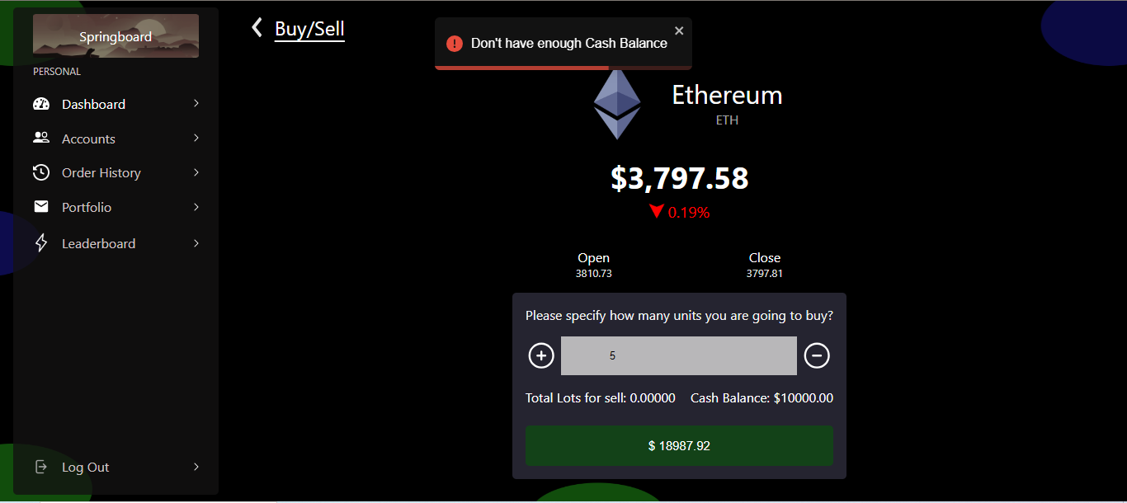
BUY

Slide 25
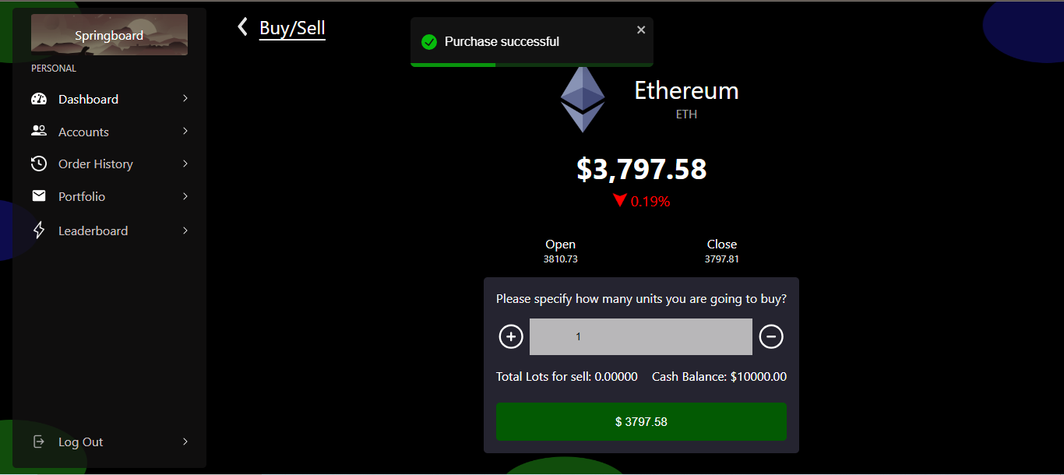
BUY

Slide 26
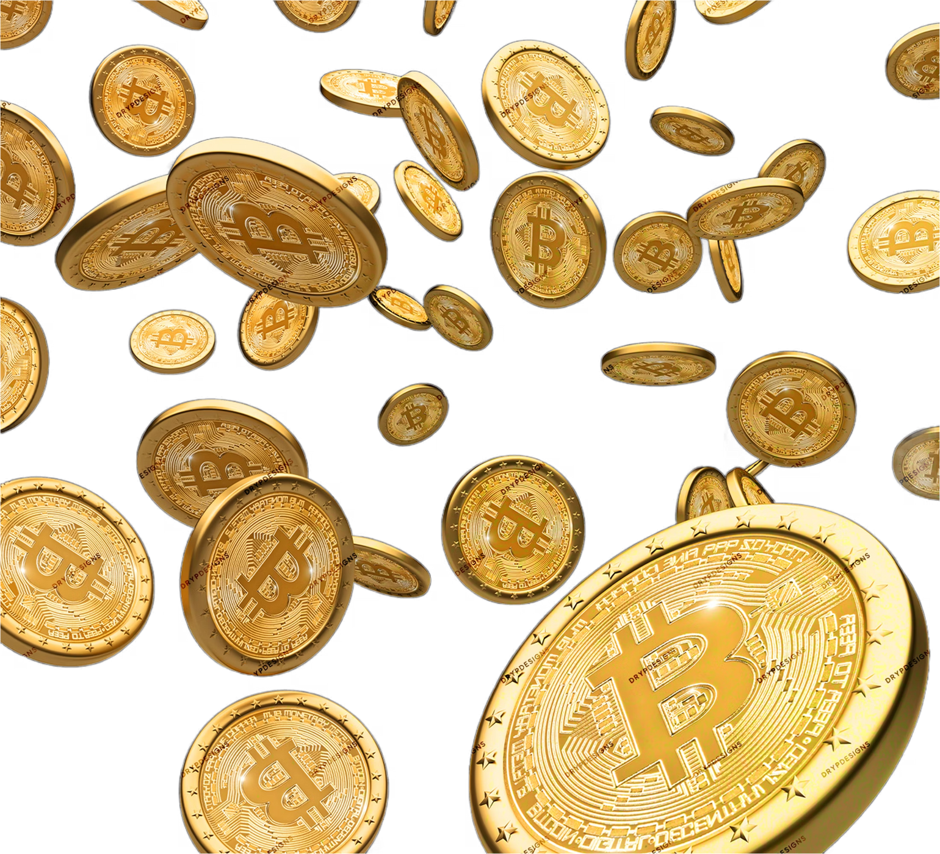
CRYPTO SELL
Select Crypto to sell
See Crypto Details
Check Owned Crypto
Enter quantity
Confirm sale

Slide 27
CRYPTO DETAIL

Slide 28
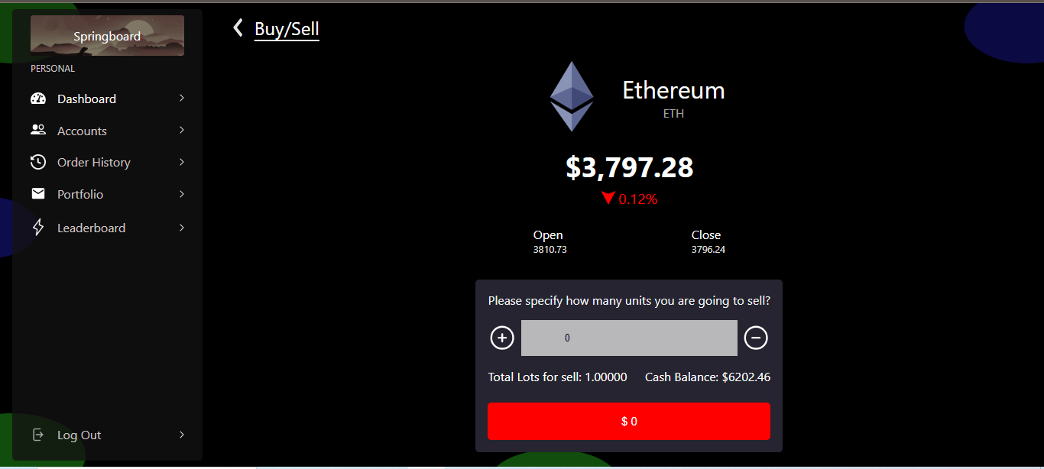
SELL

Slide 29
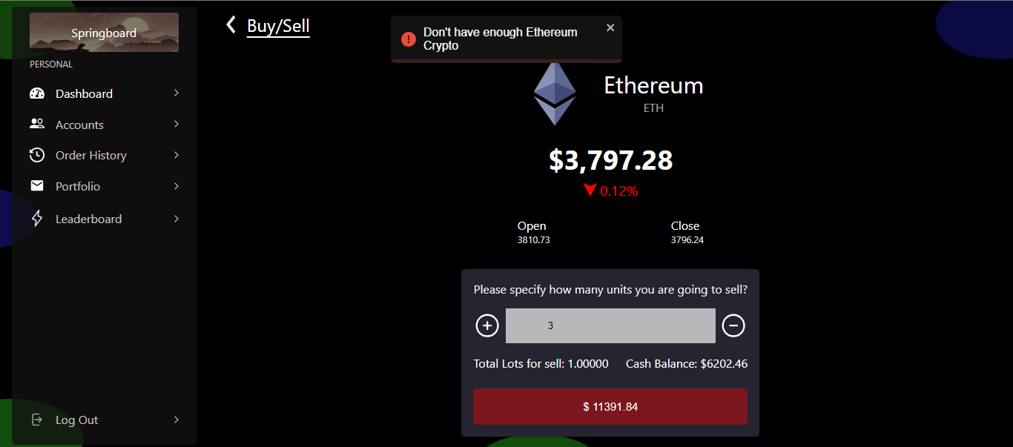
SELL

Slide 30
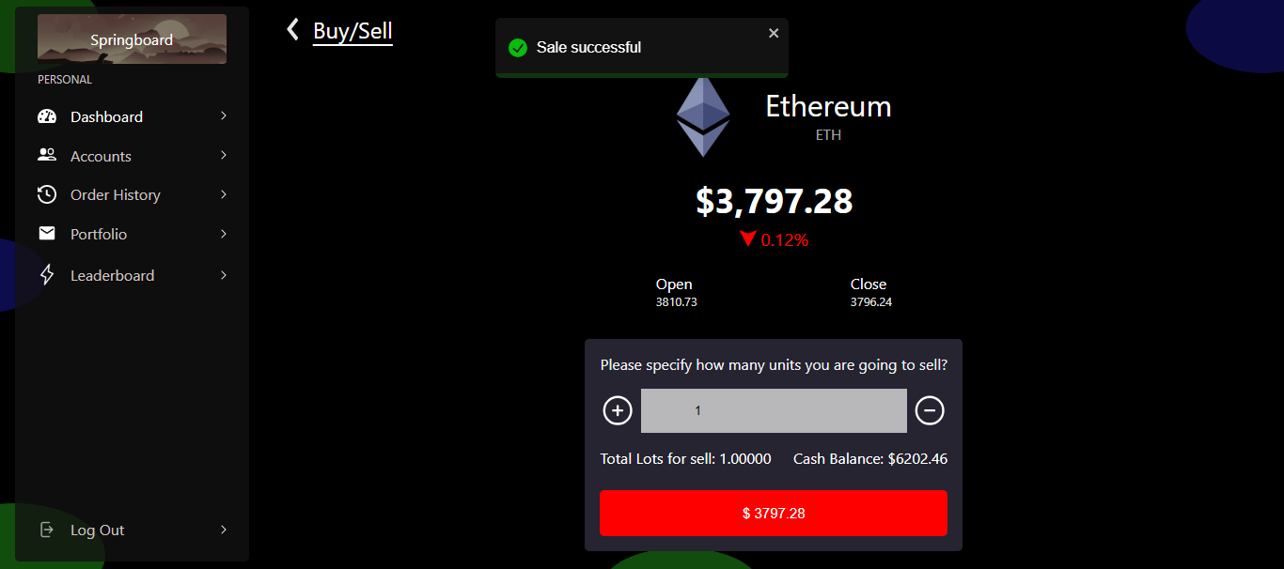
SELL

Slide 31
PORTFOLIO
Overview of portfolio
displays total profit, total loss, today profit and today loss
display total cash balance

Slide 32
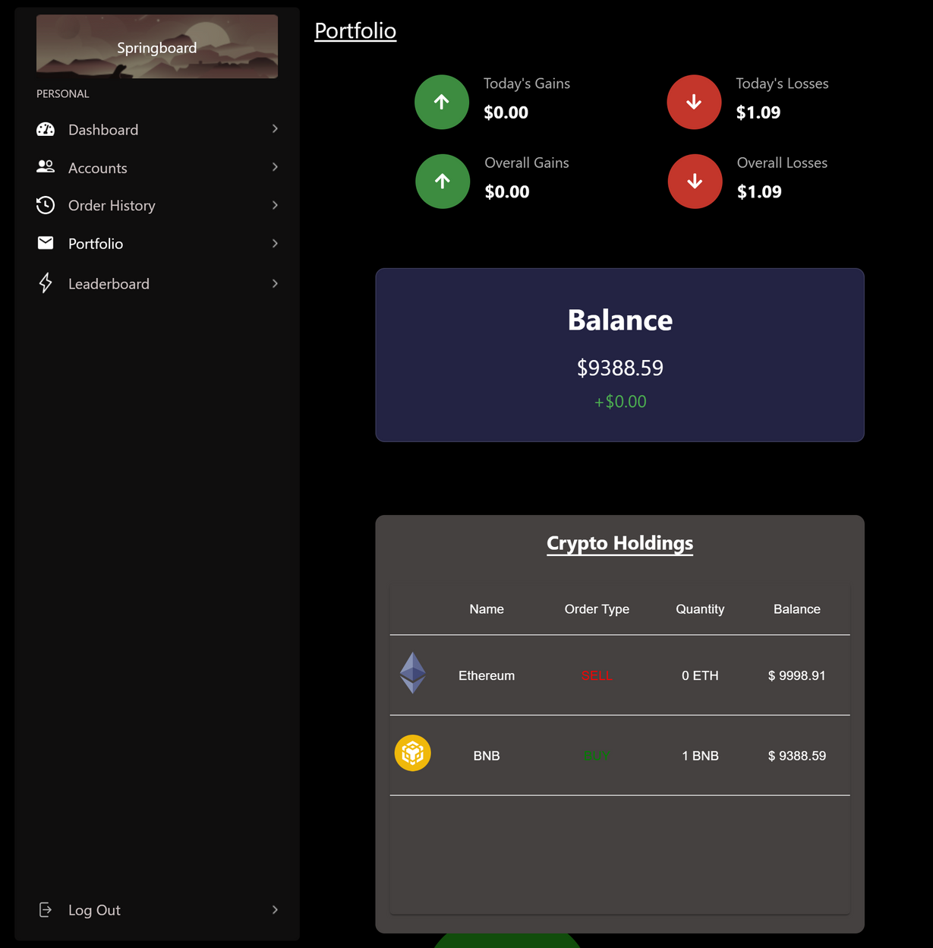
PORTFOLIO

Slide 33
ACCOUNT PAGE
User profile
Update personal information
Security settings

Slide 34
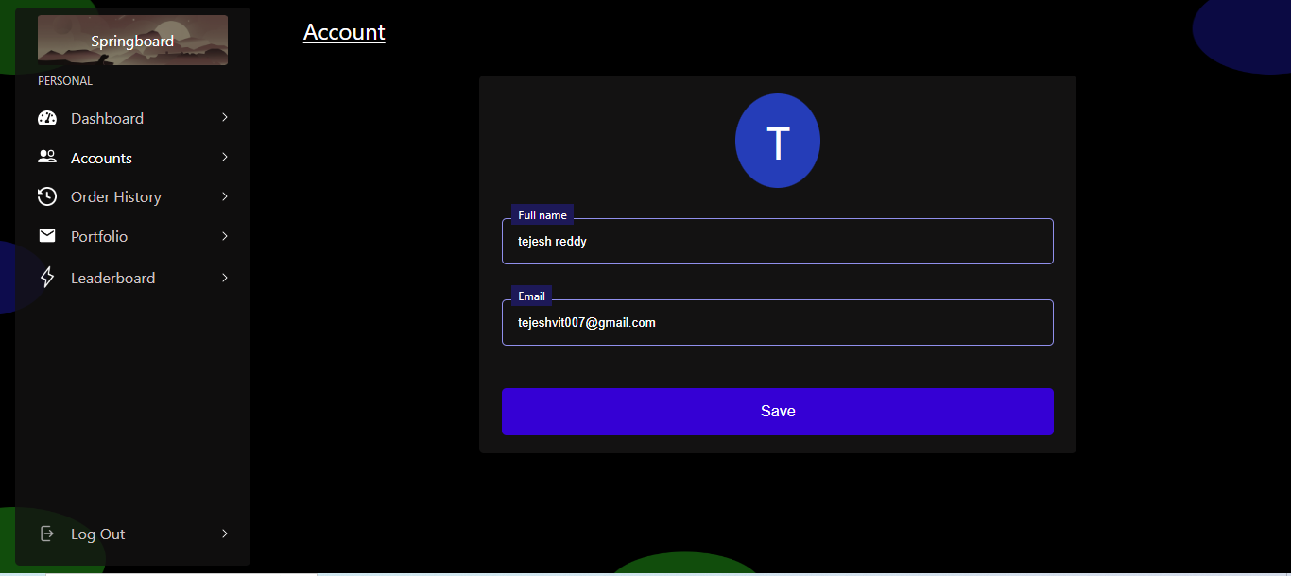
ACCOUNT PAGE

Slide 35
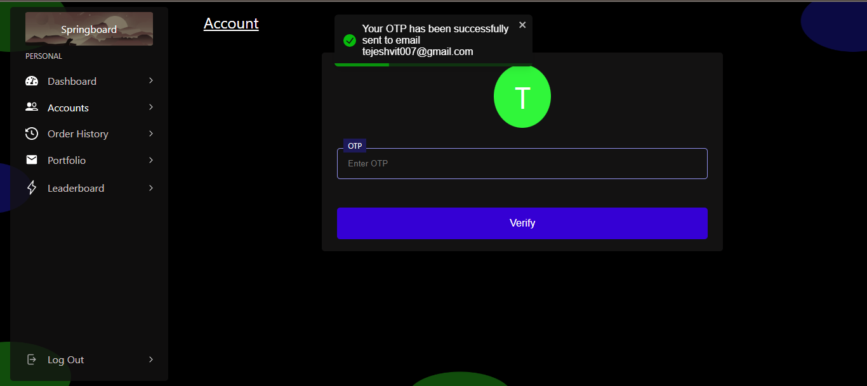
ACCOUNT PAGE

Slide 36
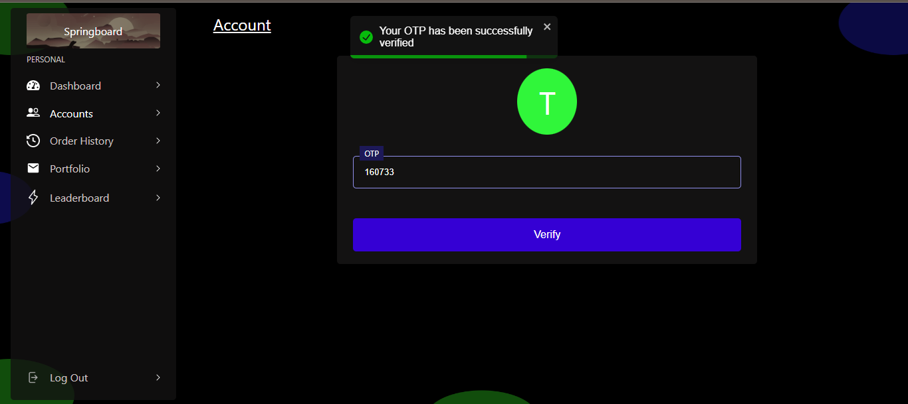
ACCOUNT PAGE

Slide 37
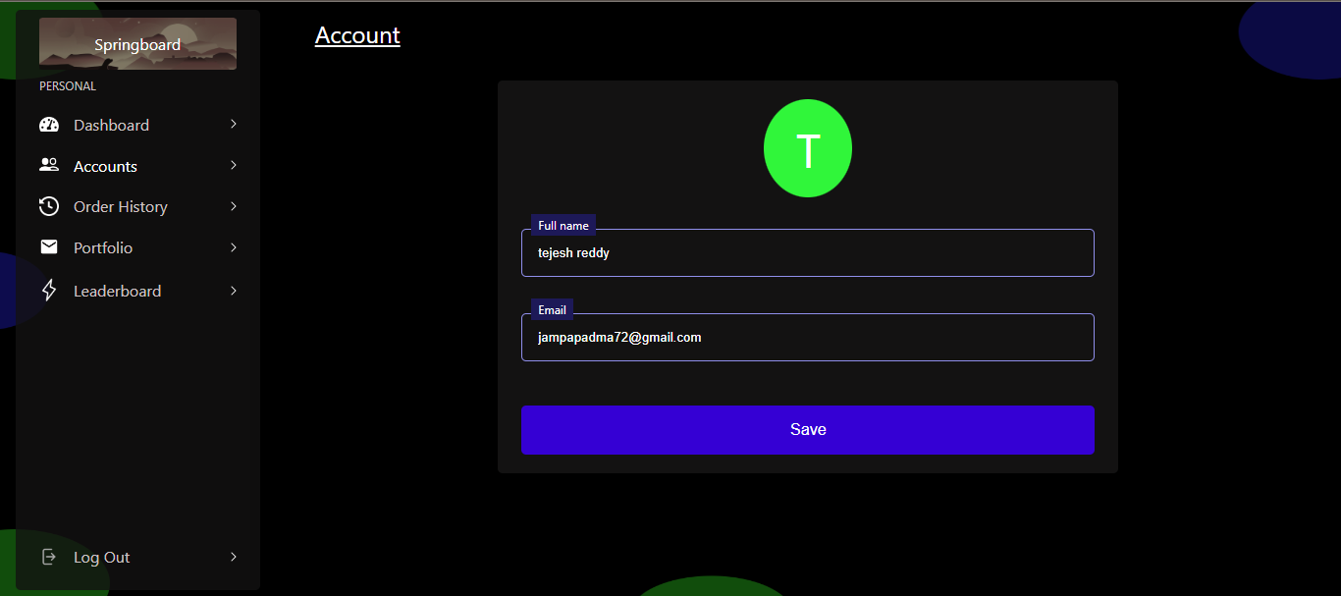
ACCOUNT PAGE

Slide 38
LEADERBOARD
Top performers
Criteria for ranking - Most amount of profit

Slide 39
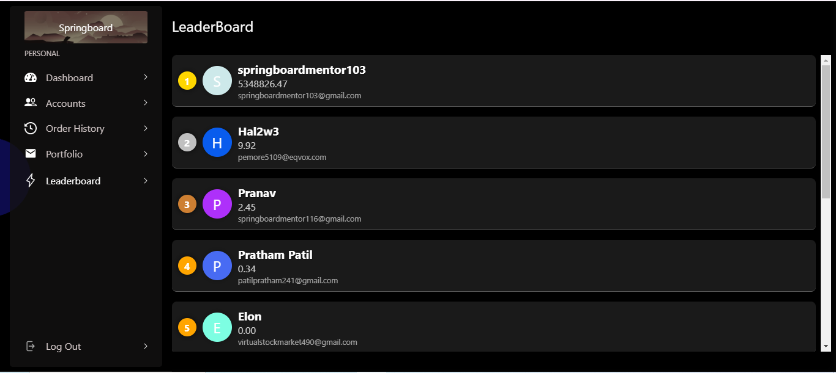
LEADERBOARD

Slide 40
ORDER HISTORY
List of past transactions
Date and time
Status (completed/pending)

Slide 41
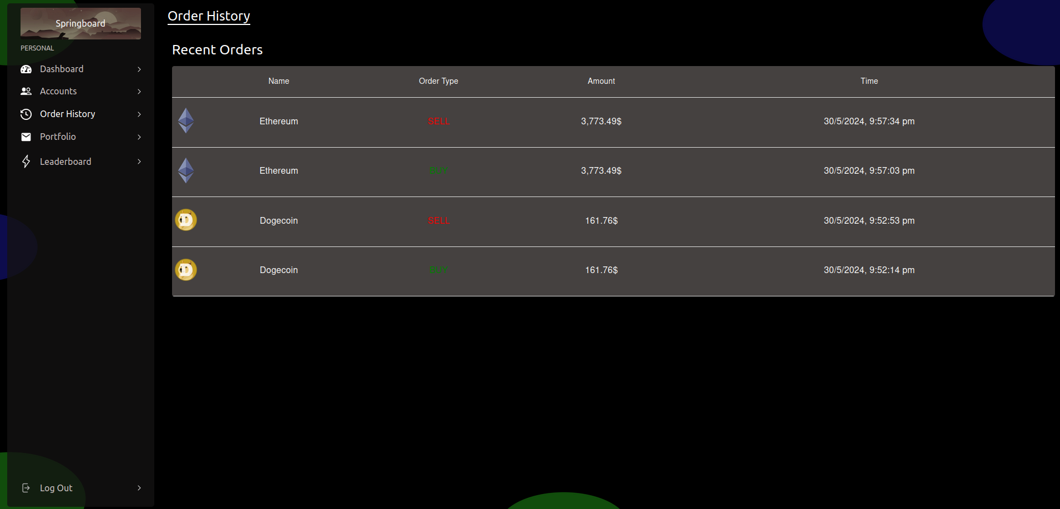
ORDER HISTORY

Slide 42
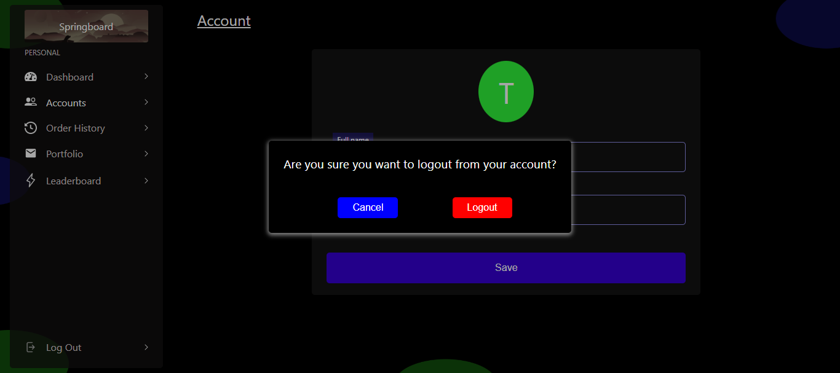
LOG OUT

Slide 43
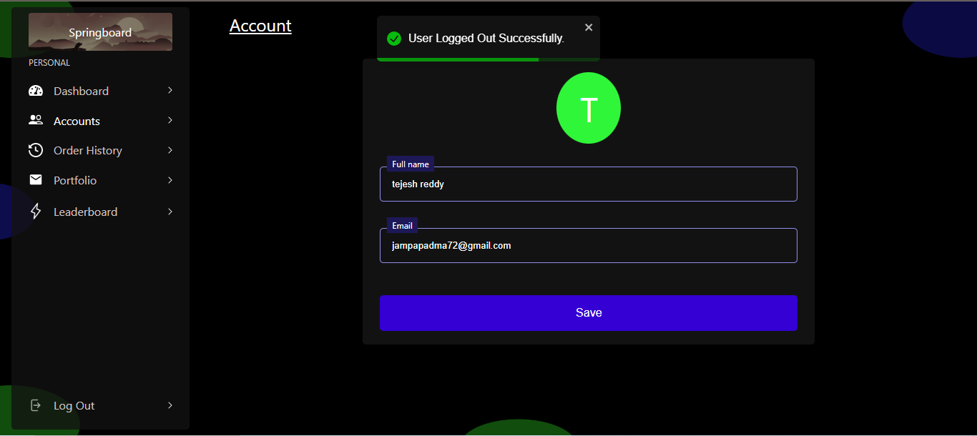
LOG OUT

Slide 44
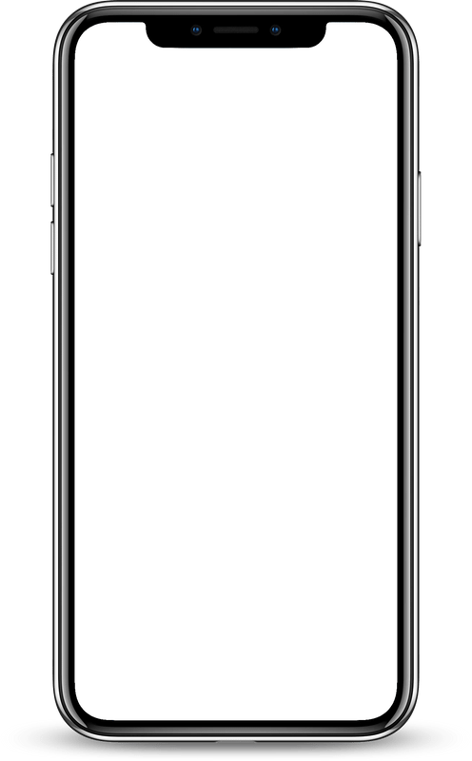
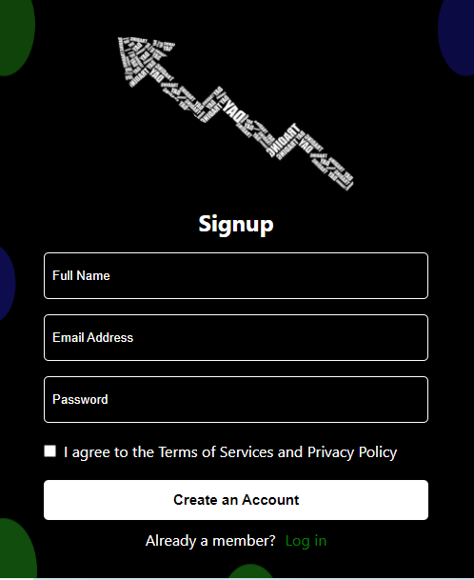
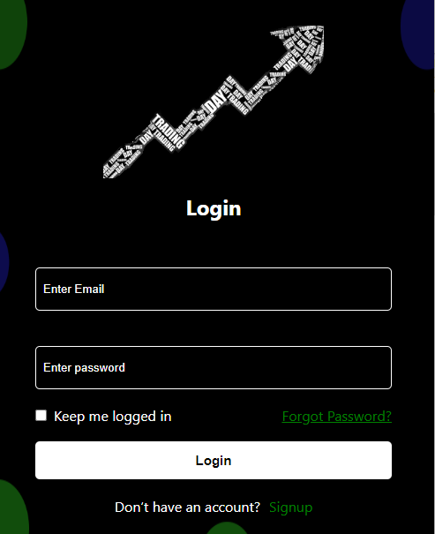

Slide 45
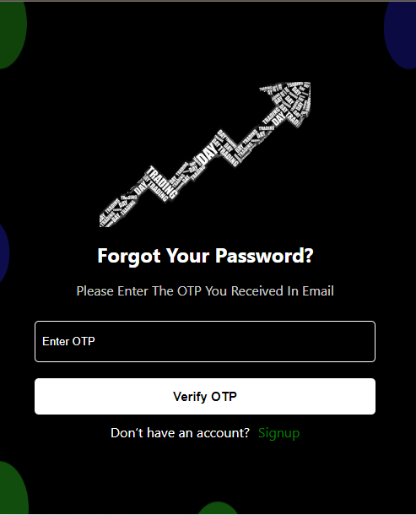
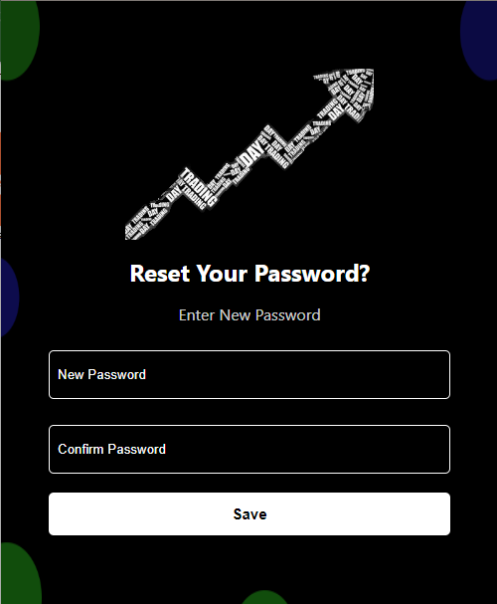

Slide 46
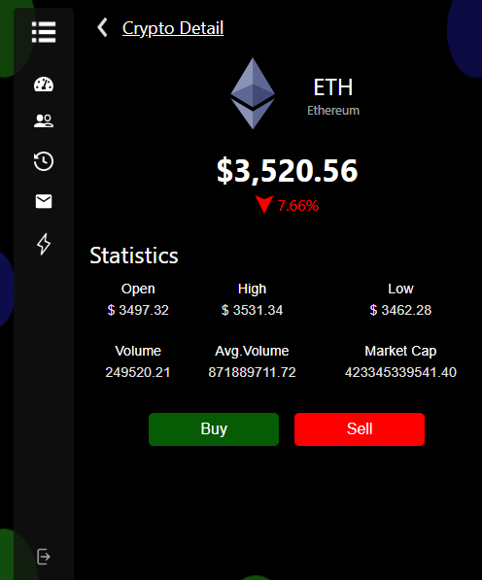
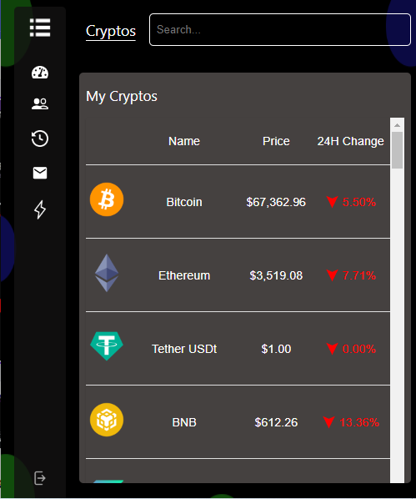
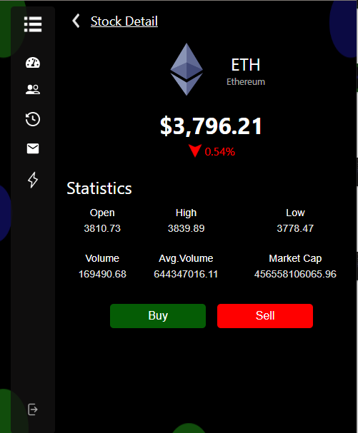

Slide 47
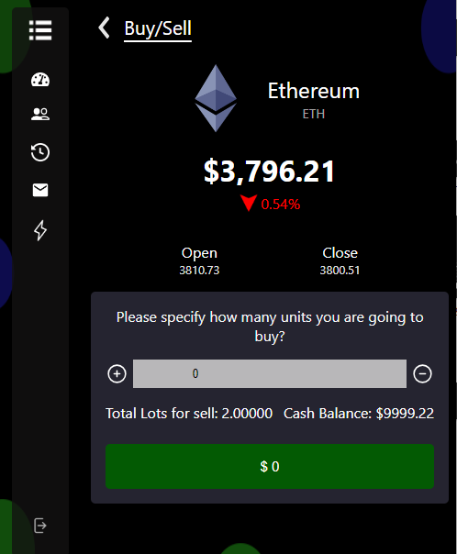
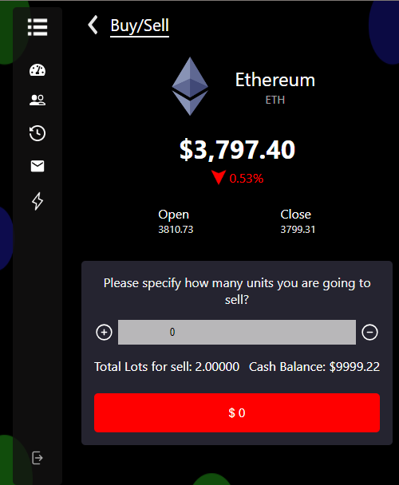

Slide 48
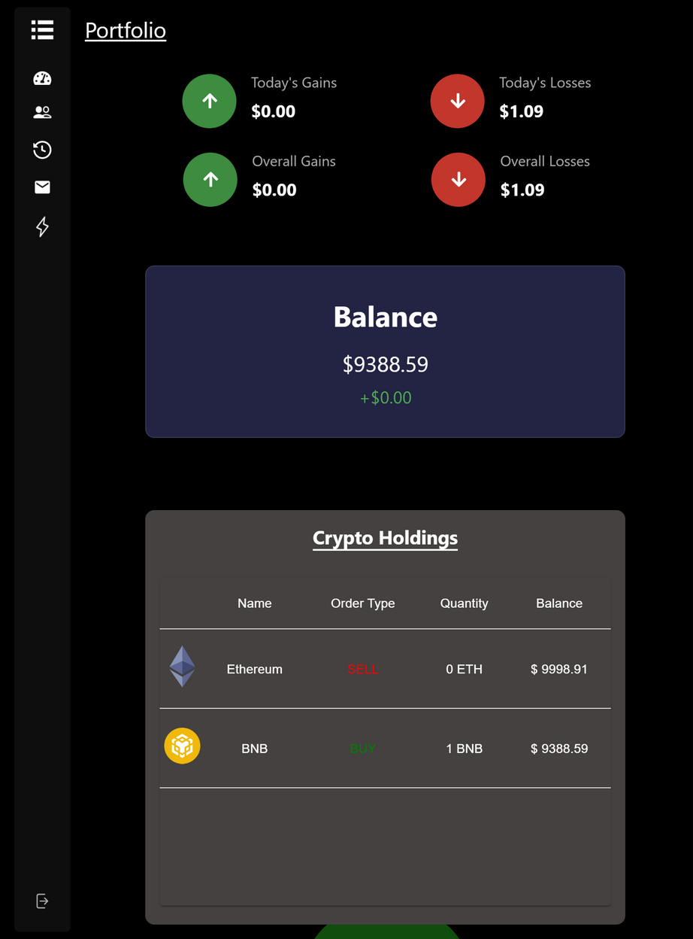
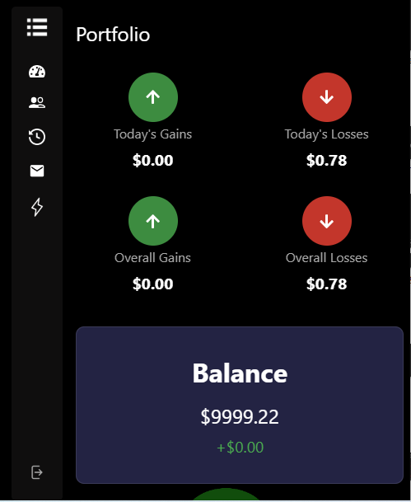
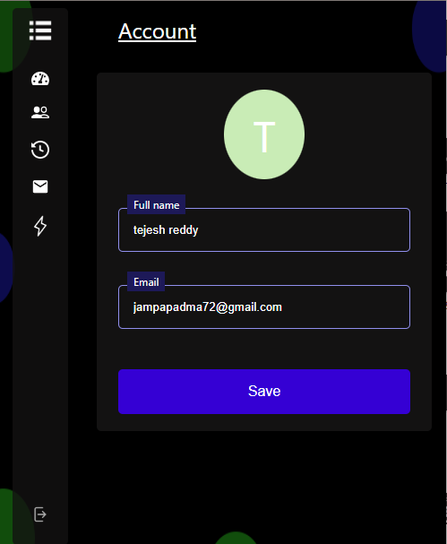

Slide 49
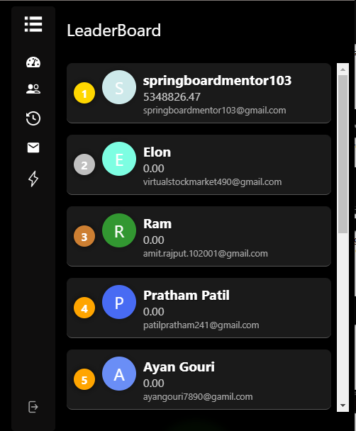
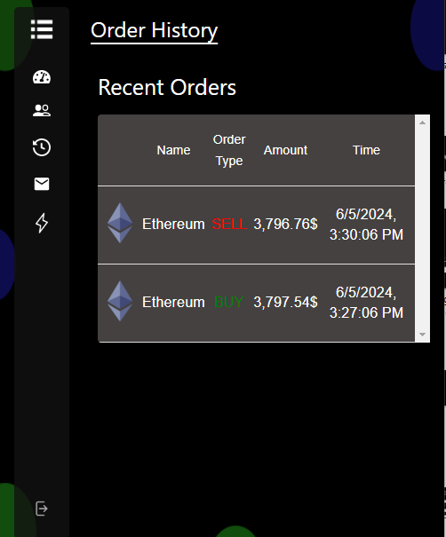

Slide 50
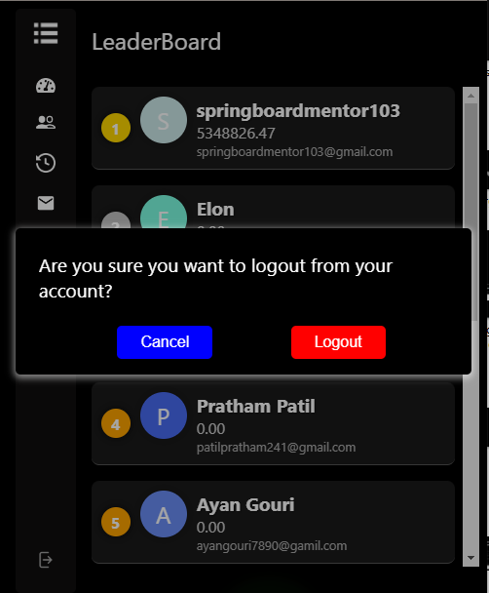

Slide 51

Our Best Team
Tejesh
Mayur
Keerthana
Karthik
Pavithra R
Shriram
Manveer
Puneet
Lakshita
Ayush
Pratham
Ayan

Slide 52


Slide 53
Thank You
FOR YOUR ATTENTION

